Slide 2
Elizabeth Middle School
SHOWCASE
2016

Slide 3
2015-2016 EMS Staff

Slide 4
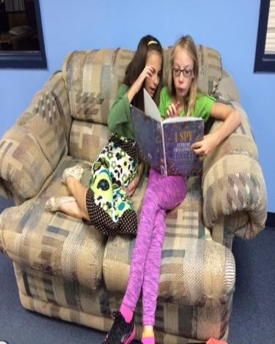
EMS Library

Slide 5
Library and Changing Themes

Slide 6
Students Researching in the Library

Slide 7
Students Applying Research

Slide 8
6th Grade Math
Students designed a Dream House following certain specifications.
Measure Me Metrically

Slide 9
Depth and Complexity Materials

Slide 10
Students helping to unpack materials

Slide 11
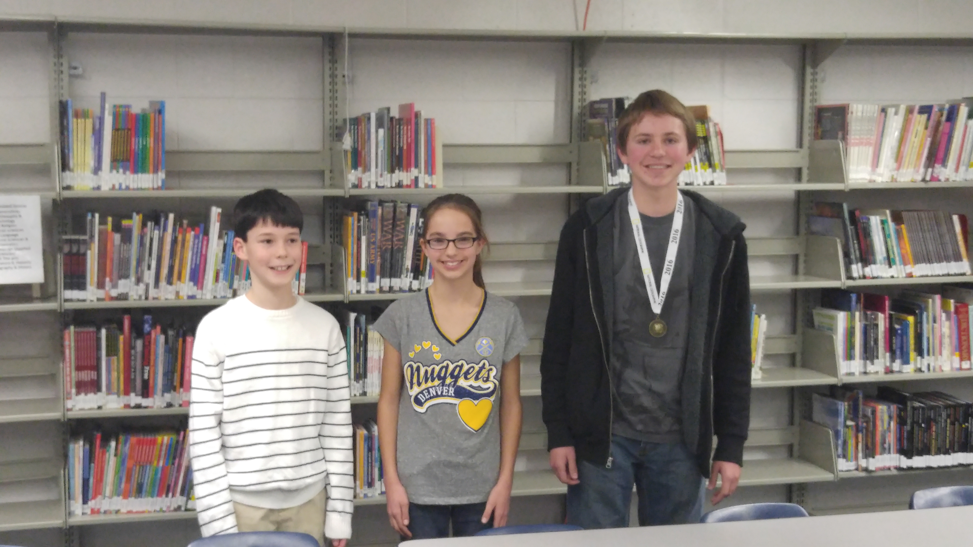
Geography Bee
Geography Bee winners:
Brandon Marshall 8th grade 1st place
Piper Gustafson 6th grade 2nd place
Ian Christiansen 6th grade 3rd place
Sponsor – Lori Williams Martin
Winners

Slide 12
Book Club with the Counselors
There are currently
8 students in the book club.
The students are reading the following books;
Harry Potter
Diary of a Wimpy Kid
The Maze Runner
A Million Ways Home
Looking for Alaska

Slide 13
7th and 8th Grade Published Books Project
Mrs. Brown's 8th grade Language Arts class is involved in a project where each student is creating a narrative that will be turned into a hardbound book! The project is called “In Search of Wisdom.” Over winter break, students interviewed someone who is at least 55 years of age or older and, upon their return to school, began writing the story down in narrative form. The students will be writing the story in first person point of view, which means they will write the story as if the experience actually happened to them, so that they can fill in the details and embellish the story as needed to make the story fun and exciting.
Mrs. Brown’s 8th Grade Class

Slide 14
This project gives the students an authentic assessment in writing and it is highly motivating as well. ~ Julie Reese, 7th Grade LA
8th Grade Published Books
The publishing company is a well-known company called Student Treasures; they have been successfully publishing student narratives for many years as a service to public and private education. Our books will be electronically sent to the publisher on February 26th and returned approximately two weeks later. The first week of April students will attend Author's Night where they will represent their books and present them to the public.
~Shelby Brown, 8th Grade LA
Examples from 2014-2015

Slide 15
Student Art Work Mural in the Counseling Office
This mural was painted by Carlie Connelley and Madison Schiefelbein

Slide 16
Fitness Walking at EMS
Fitness Walking at EMS
As a part of the district wellness committee incentive, EMS Students are walking laps not only for their physical fitness but for brain fitness. Studies have shown that if students move in the AM brain activity increases also. Math and Reading scores across the US have gone up with schools that exercise before school.

Slide 17
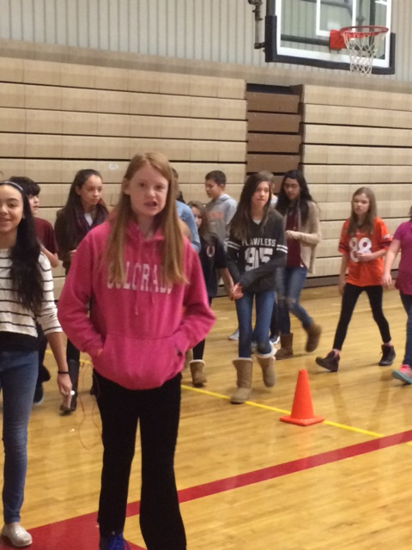
Fitness Walking
Fitness walking has approximately 60 – 70 students that participate each morning.
Lynne Watts calculates minutes or mile and applies it toward
Walking Across Colorado
or
Climbing 14er’s

Slide 18
7th Grade Science
“I think Study Island is a great tool for me. I LOVE IT because you can practice as much as you like and actually do good on the tests. If you get something wrong you can see why and find the right answer”.
“I feel as though Study Island has very much benefitted the 7th grade science program. As science is an easily neglected subject, Study Island brings more focus to the necessary practice. The future cannot be successful without science. Study Island's practice and tests drill the needed information into our heads”. - Izzy McCarty

Slide 19
What 7th Grade Students are saying about Study Island
“I think Study Island is beneficial because if you get a question wrong it gives you an explanation of why your answer is wrong and lets you pick the correct answer”.
“It helps me study in a fun way! :)” - Brody Sprouse
“The benefits of Study Island is its a good studying tool when no one else can test you. You can practice at home easily. Overall I love it!”
“I think Study Island is beneficial because it helps maintain study habits. It tells us how we've improved and what we need to work on. Also, it gives us an idea of what will be on our tests”. ---Megan Timpson

Slide 20
Other Great Things that are Happening at
EMS

Slide 21
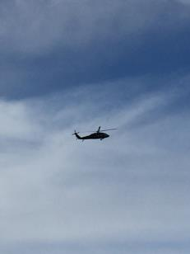
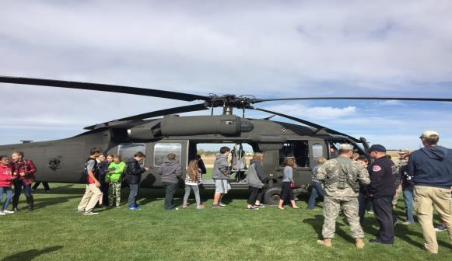
Red Ribbon Week The National Guard Helicopter

Slide 22
Red Ribbon Week Elbert County Sherriff

Slide 23
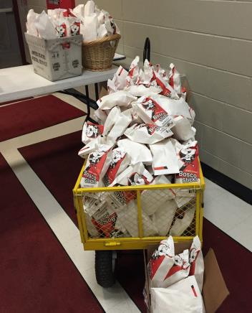
Preparing for Movie Night

Slide 24
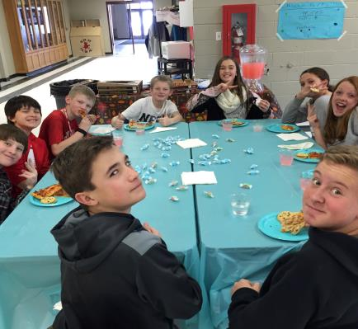
PBIS Y.E.S Card Pizza Party Winners

Slide 25
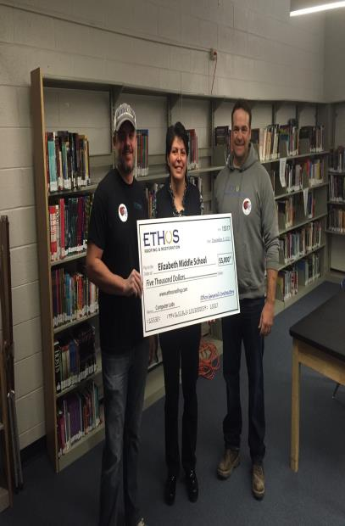
ENG a Community Event
Thanks to ETHOS and the Elizabeth Community. Through community support ETHOS was able to donate $5000 to EMS

Slide 26
Drama and Choir

Slide 27
Athletics

Slide 28
More Sports

Slide 29
Next Year…
We are working on our next years master schedule hoping to keep it very similar to this years schedule.
We are in the process of aligning our schedule with EHS to better service our students taking classes at the high school.
We will continue to work with RCE and SHE on curriculum alignment and 5th grade transition.
Teachers will continue to get training on “Depth and Complexity” and how to implement it into their classrooms.

Slide 30
We will continue to work with RCE and SHE on curriculum alignment and 5th grade transition.
We will continue to work on school climate and providing students with a variety of activities.

